Slide 1
Instant Messaging service using RESTful Web Services and WebSockets
Juan Luis Gorricho

Slide 2






Second approach
This is a second approach implementing an instant messaging service, a remote approach without persistence.
This approach focuses on using a web application service and on accessing the service using a REST API.
The approach uses Swing clients instead of Internet browsers, and the asynchronous behavior will be implemented with a pushing strategy using a WebSockets library. The client has no persistence either.

Slide 3



Exercise
Open the InstantMessagingRemote_server web application project. Import the GSON library from the libs folder if necessary.
Add the code from the previous exercise implementing: PublisherImpl and TopicManagerImpl, be careful not to delete some extra methods.
Run the web application project.

Slide 4



Exercise
Try to understand the meaning of all the code contained in the web app. project.
In particular, review:
– The two FacadeREST included in the facadeREST package. Review the syntax specifying the URL paths to be used to execute the different methods. Pay attention to the use of an instance of Global, with application scope, to retrieve the instance of TopicManager.

Slide 5



Exercise
In particular, review:
  The programming of WebSocketServer where the server only accepts subscription requests from its clients to subscribe or unsubscribe that client to a topic.
  The programming of SubscriberImpl where we use a WebSocket session to asynchronously send messages to the client.

Slide 6




Exercise
Open the InstantMessagingRemote_client_exercise.
Try to understand the coding of the Java classes included in apiREST as an example of the usual programming of a REST API. Notice all methods are programmed as static methods.
Copy and paste the code of the SwingClient Java class from previous version.
Complete the code of PublisherStub and TopicManagerStub, basically, to execute remote calls using the apiREST; except for the subscribe() and unsubscribe() methods where you have to use the WebSocketClient methods, why?

Slide 7

Exercise
Complete the code of the WebSocketClient in accordance with the programming of the WebSocketServer and the SubscriberImpl at the server side.
Review the schema of classes of the following slide for a better understanding of the exercise.
Run separately two clients with different user names to test the code.

Slide 8
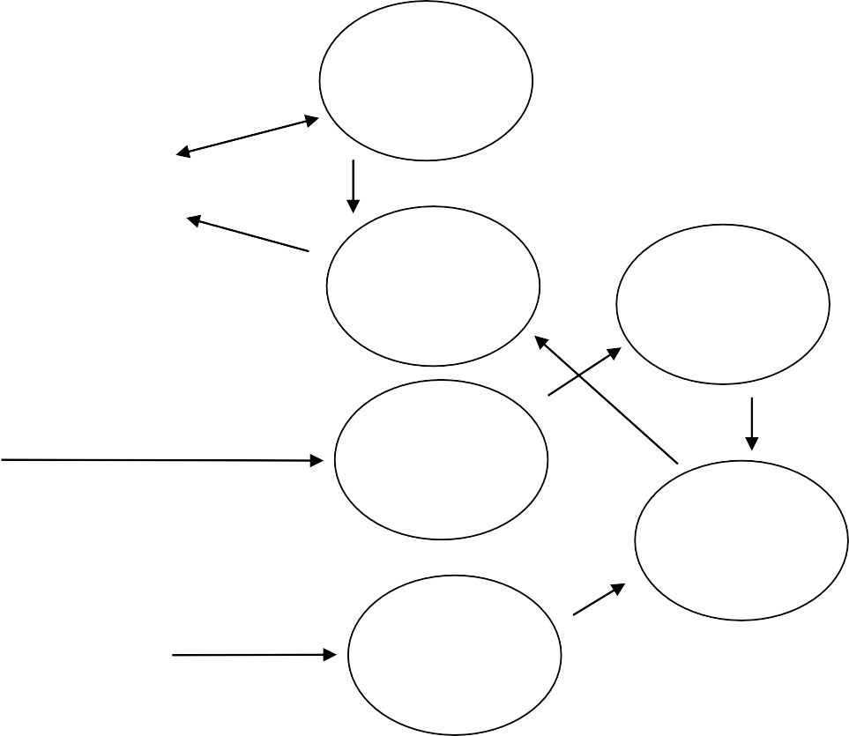
Schema of classes for a remote service
(only one per topic allowed)
WebSocket Server
new
new subs.
Subscriber
WebSocket
new
Client
...
_{subs.} (only one with
subs. mapping)
Subscriber
add
TopicManager
new topic
TopicManagerStub
TopicManager FacadeREST
new
Publisher
new
new mess.
PublisherStub
Publisher FacadeREST
...
IM client
(one per publisher)
IM server

